Slide 1

Estimating the Circuit De-obfuscation Runtime based on Learning Methods
Fifth Presentation

Slide 2
Work Report

Slide 3
Work Report
Conducted works on this week
Implementing CNF-NET on the C499 dataset based on paper [1]
[1] SEPIANN: Security Evaluation Platform for SAT-Hardness using Intelligent Artificial Neural Net
Notes:
Infertility : inability of couples to achieve pregnancy in one year.
It can have adverse effects on family’s aspects of life.
About 30-50% of infertility cases are due to male factor.
Semen analysis is the first step in diagnosis and treatment of male infertility.
Microscopic parts of semen analysis assess characteristics of sperm cells.

Slide 4
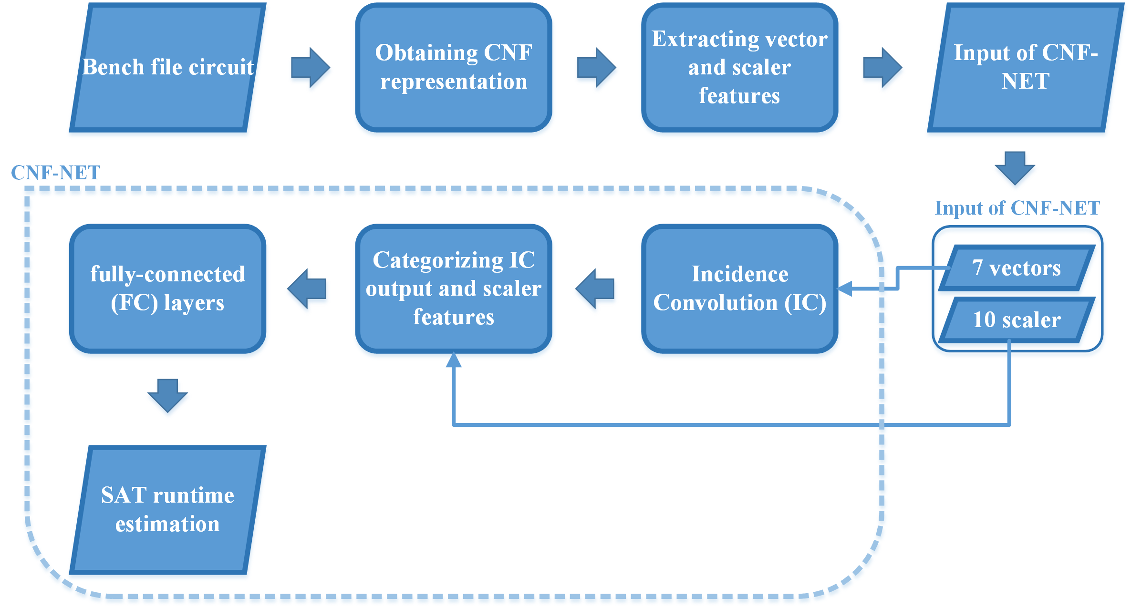
Overview of the CNF-NET
Notes:
Infertility : inability of couples to achieve pregnancy in one year.
It can have adverse effects on family’s aspects of life.
About 30-50% of infertility cases are due to male factor.
Semen analysis is the first step in diagnosis and treatment of male infertility.
Microscopic parts of semen analysis assess characteristics of sperm cells.

Slide 5
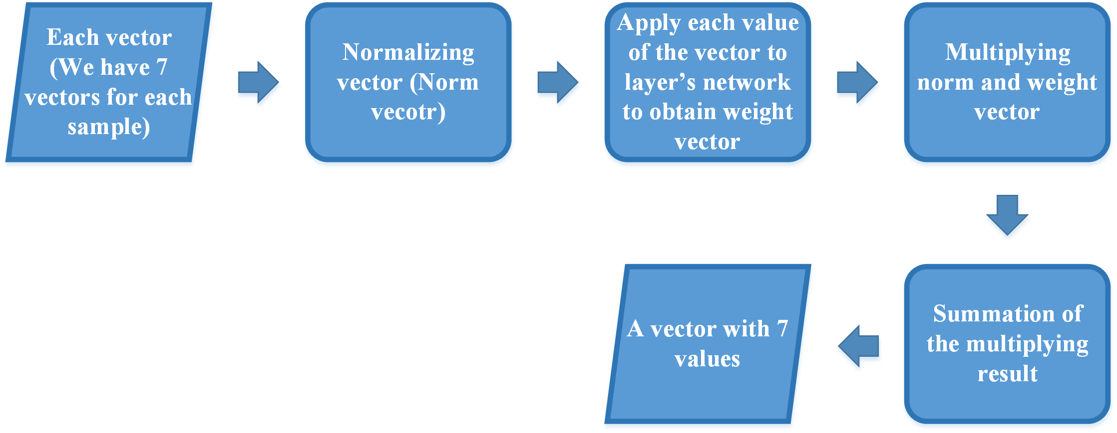
Incidence Convolution
The layers of the IC network
No | Layer | Input | Output
1 | Fully-connected | 1 | 32
2 | Fully-connected | 32 | 32
3 | Fully-connected | 32 | 32
4 | Fully-connected | 32 | 1
Notes:
Infertility : inability of couples to achieve pregnancy in one year.
It can have adverse effects on family’s aspects of life.
About 30-50% of infertility cases are due to male factor.
Semen analysis is the first step in diagnosis and treatment of male infertility.
Microscopic parts of semen analysis assess characteristics of sperm cells.

Slide 6
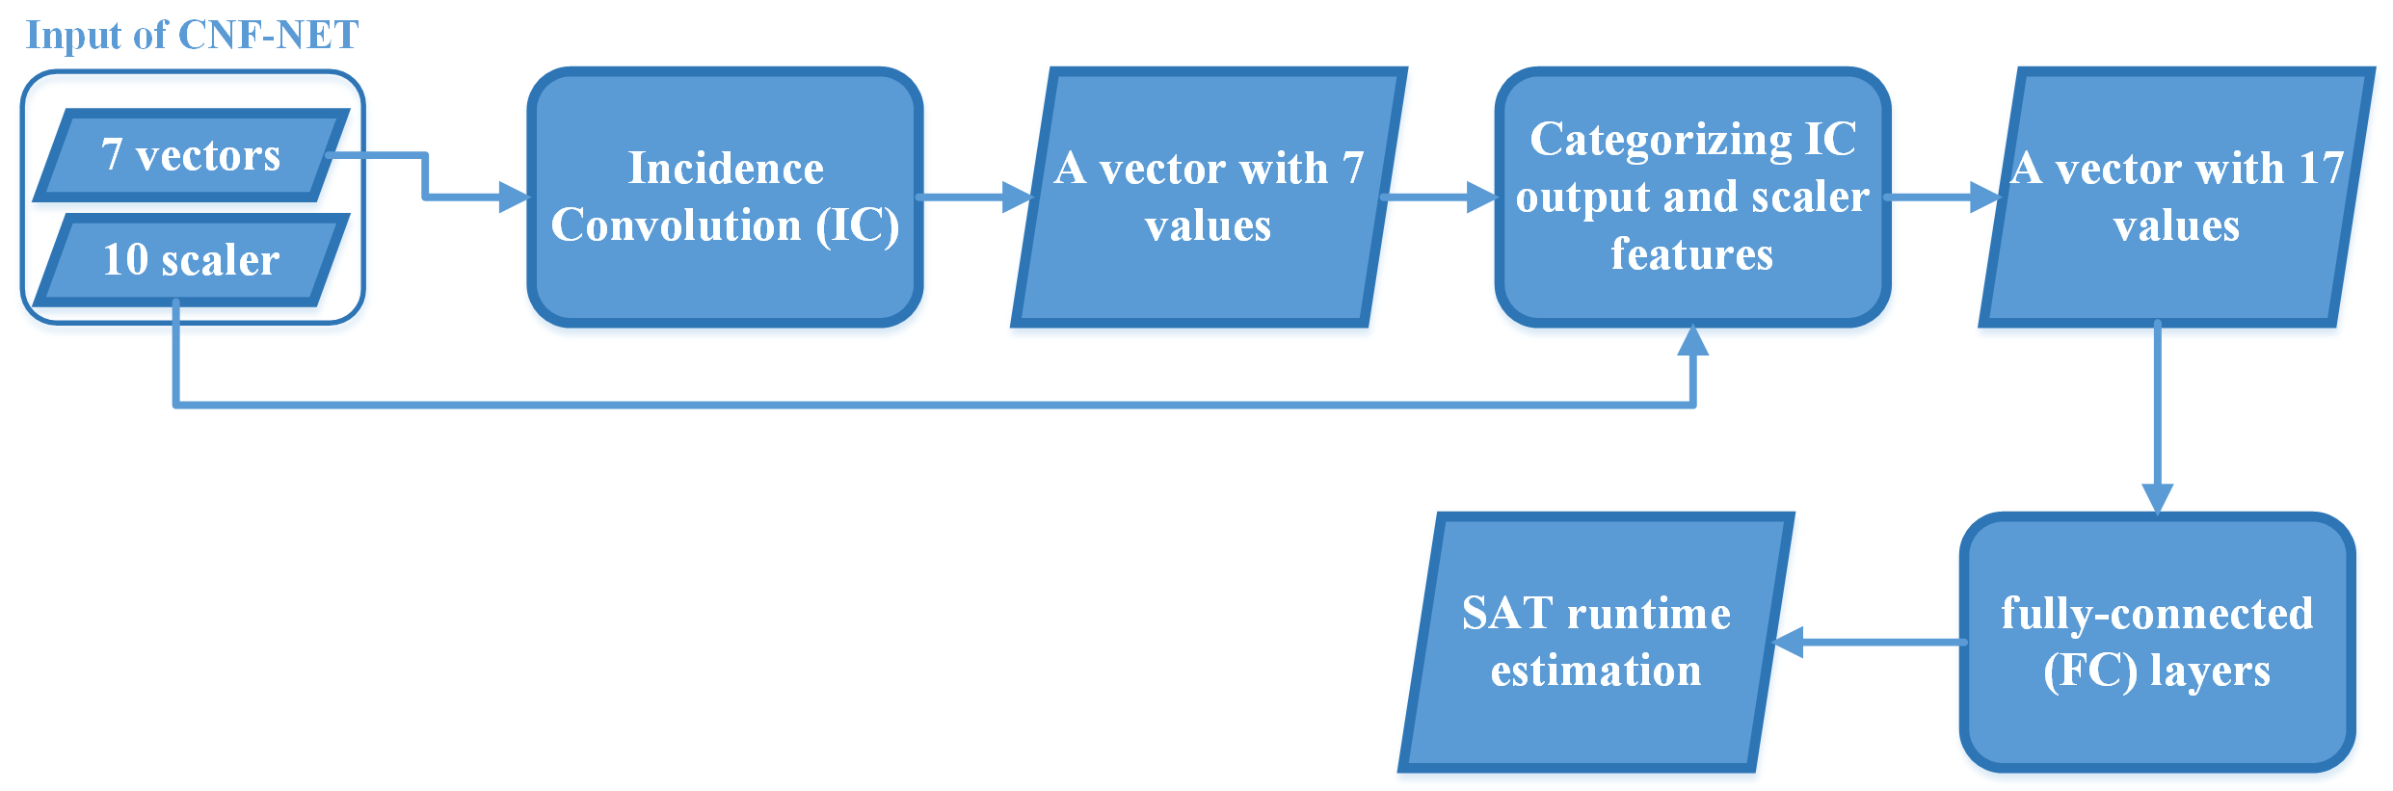
Fully-connected layers (FC)
The layers of the FC network
No | Layer | Input | Output
1 | Fully-connected | 17 | 32
2 | Fully-connected | 32 | 32
3 | Fully-connected | 32 | 32
4 | Fully-connected | 32 | 1
Notes:
Infertility : inability of couples to achieve pregnancy in one year.
It can have adverse effects on family’s aspects of life.
About 30-50% of infertility cases are due to male factor.
Semen analysis is the first step in diagnosis and treatment of male infertility.
Microscopic parts of semen analysis assess characteristics of sperm cells.

Slide 7
Implementation details of CNF-NET
We applied the C499 dataset to CNF-NET to evaluate it using mean square error (MSE) metric.
80% of dataset → Training set
10% of dataset → Validation set
10% of dataset → Testing set
Evaluating the CNF-NET was repeated 7 times
The results were averaged to derive the mean and standard deviation of the metrics for each model.
Each repetition was denoted by K.
Notes:
Infertility : inability of couples to achieve pregnancy in one year.
It can have adverse effects on family’s aspects of life.
About 30-50% of infertility cases are due to male factor.
Semen analysis is the first step in diagnosis and treatment of male infertility.
Microscopic parts of semen analysis assess characteristics of sperm cells.

Slide 8
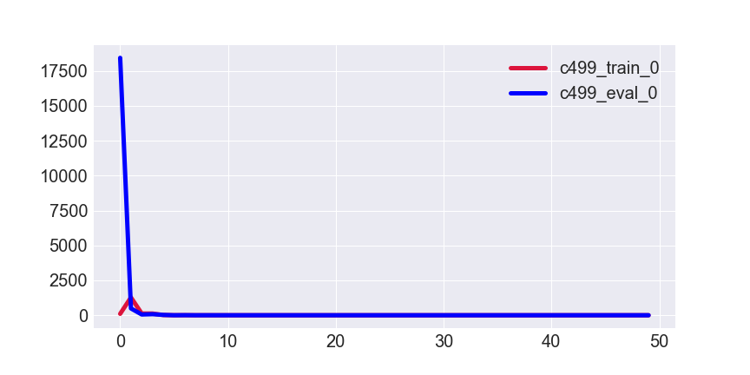
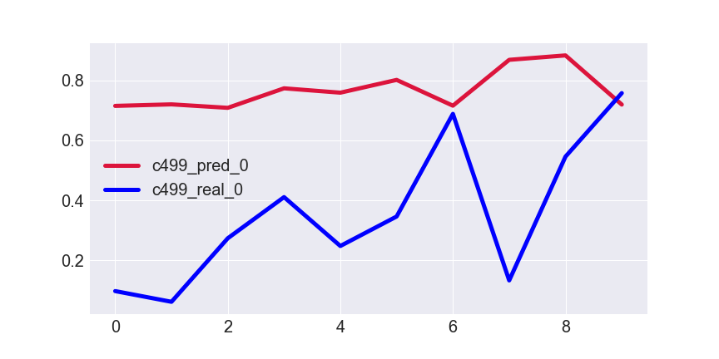
Results for K=1
De-obfuscation runtime
Normalized de-obfuscation runtime
Epoch
Testing data index
MSE for testing set → 0.2260
Notes:
Infertility : inability of couples to achieve pregnancy in one year.
It can have adverse effects on family’s aspects of life.
About 30-50% of infertility cases are due to male factor.
Semen analysis is the first step in diagnosis and treatment of male infertility.
Microscopic parts of semen analysis assess characteristics of sperm cells.

Slide 9
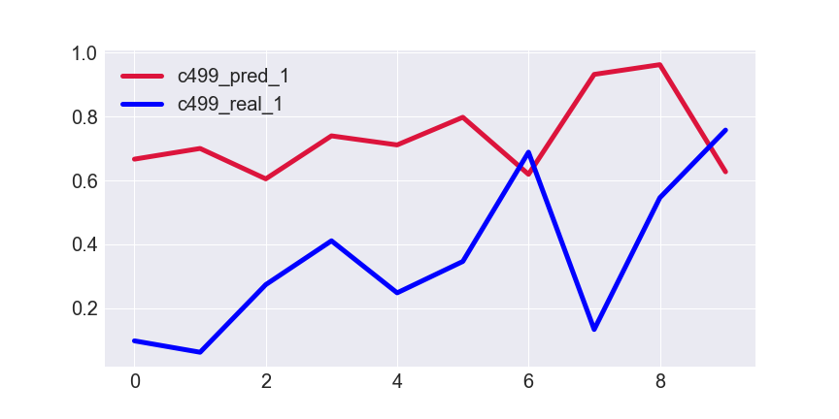
Results for K=2
De-obfuscation runtime
Normalized de-obfuscation runtime
Epoch
Testing data index
MSE for testing set → 0.2201
Notes:
Infertility : inability of couples to achieve pregnancy in one year.
It can have adverse effects on family’s aspects of life.
About 30-50% of infertility cases are due to male factor.
Semen analysis is the first step in diagnosis and treatment of male infertility.
Microscopic parts of semen analysis assess characteristics of sperm cells.

Slide 10
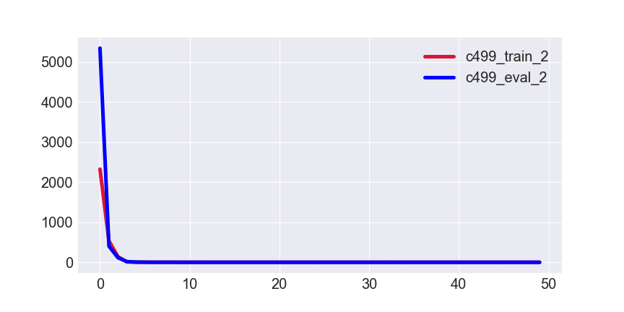
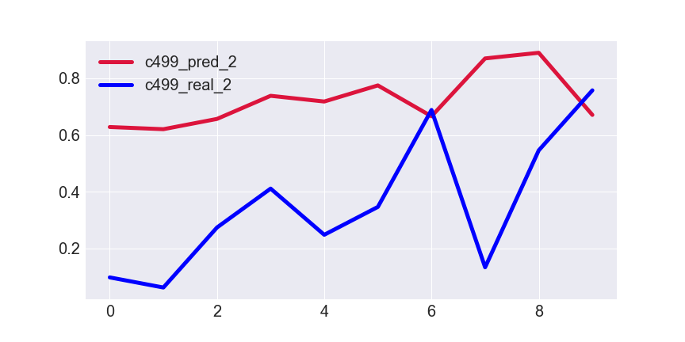
Results for K=3
De-obfuscation runtime
Normalized de-obfuscation runtime
Epoch
Testing data index
MSE for testing set →0.1922
Notes:
Infertility : inability of couples to achieve pregnancy in one year.
It can have adverse effects on family’s aspects of life.
About 30-50% of infertility cases are due to male factor.
Semen analysis is the first step in diagnosis and treatment of male infertility.
Microscopic parts of semen analysis assess characteristics of sperm cells.

Slide 11
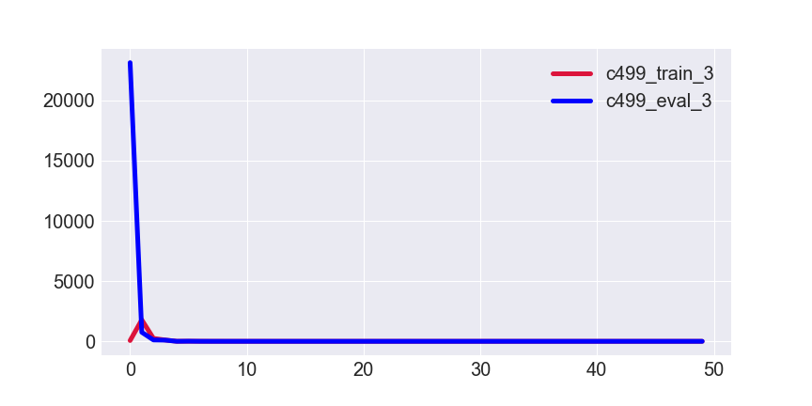
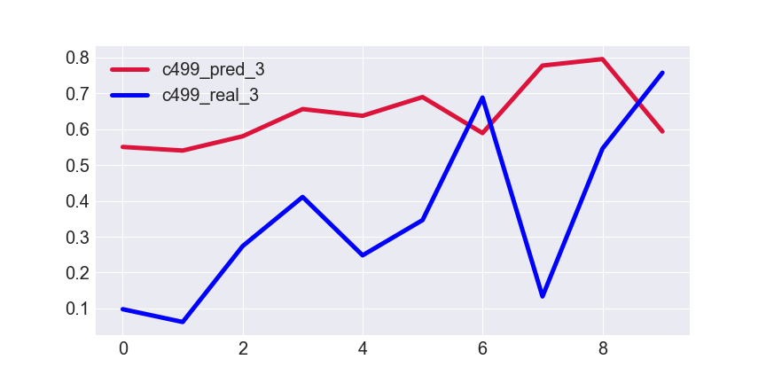
Results for K=4
De-obfuscation runtime
Normalized de-obfuscation runtime
Epoch
Testing data index
MSE for testing set → 0.1372
Notes:
Infertility : inability of couples to achieve pregnancy in one year.
It can have adverse effects on family’s aspects of life.
About 30-50% of infertility cases are due to male factor.
Semen analysis is the first step in diagnosis and treatment of male infertility.
Microscopic parts of semen analysis assess characteristics of sperm cells.

Slide 12
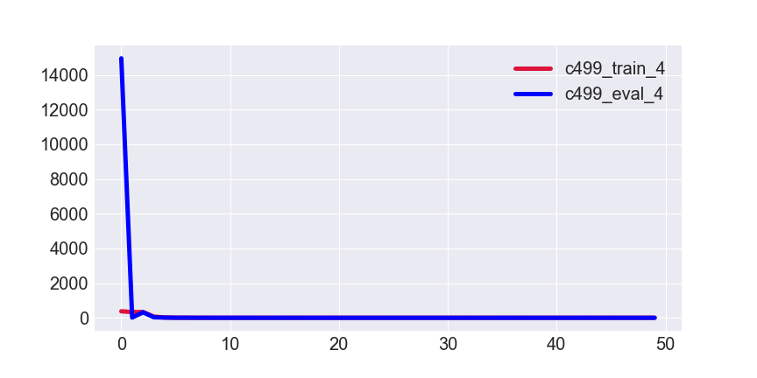
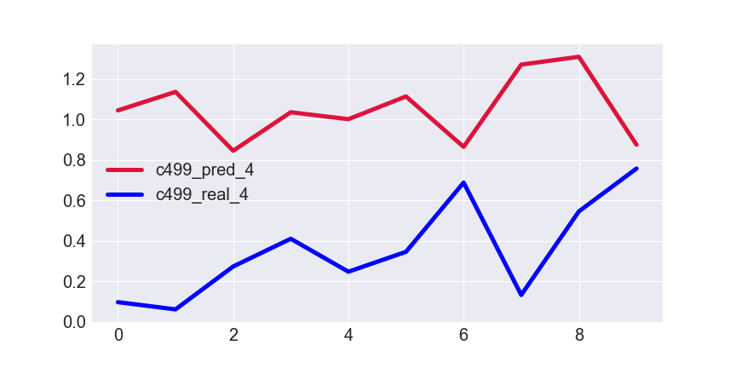
Results for K=5
De-obfuscation runtime
Normalized de-obfuscation runtime
Epoch
Testing data index
MSE for testing set → 0.5850
Notes:
Infertility : inability of couples to achieve pregnancy in one year.
It can have adverse effects on family’s aspects of life.
About 30-50% of infertility cases are due to male factor.
Semen analysis is the first step in diagnosis and treatment of male infertility.
Microscopic parts of semen analysis assess characteristics of sperm cells.

Slide 13

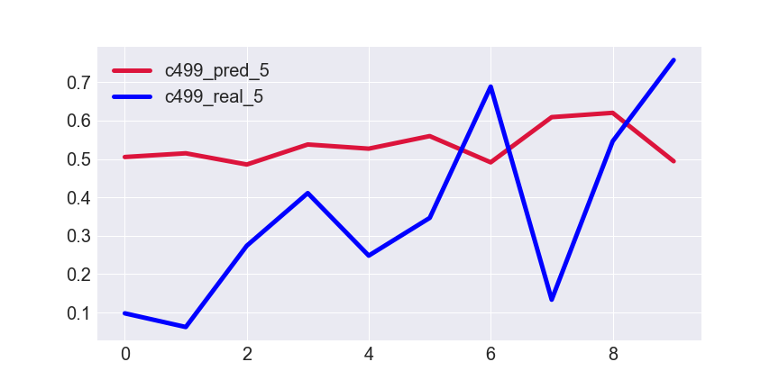
Results for K=6
De-obfuscation runtime
Normalized de-obfuscation runtime
Epoch
Testing data index
MSE for testing set → 0.0895
Notes:
Infertility : inability of couples to achieve pregnancy in one year.
It can have adverse effects on family’s aspects of life.
About 30-50% of infertility cases are due to male factor.
Semen analysis is the first step in diagnosis and treatment of male infertility.
Microscopic parts of semen analysis assess characteristics of sperm cells.

Slide 14
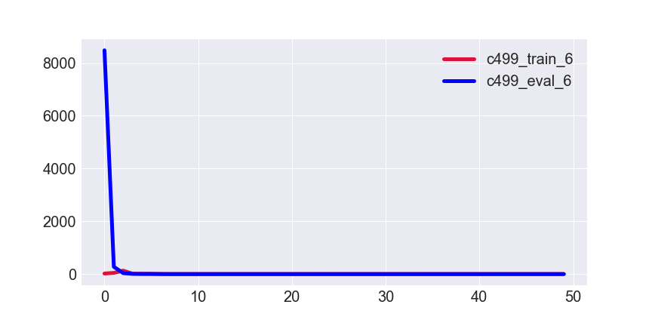
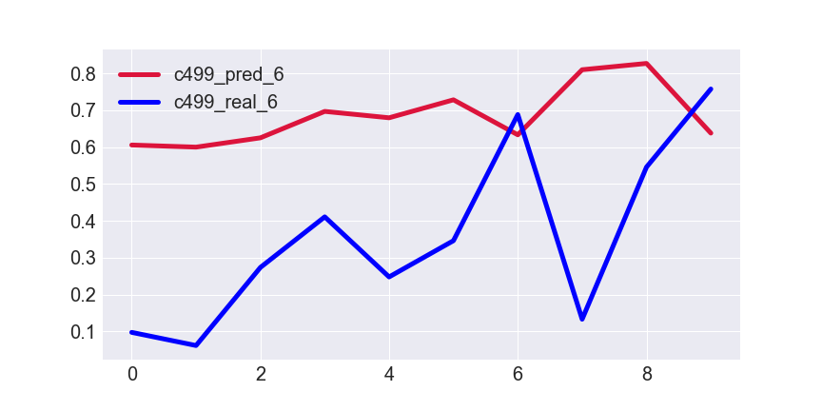
Results for K=7
De-obfuscation runtime
Normalized de-obfuscation runtime
Epoch
Testing data index
MSE for testing set → 0.1640
Notes:
Infertility : inability of couples to achieve pregnancy in one year.
It can have adverse effects on family’s aspects of life.
About 30-50% of infertility cases are due to male factor.
Semen analysis is the first step in diagnosis and treatment of male infertility.
Microscopic parts of semen analysis assess characteristics of sperm cells.

Slide 15
Table of MSE Results
K | MSE
1 | 0.2260
2 | 0.2201
3 | 0.1922
4 | 0.1372
5 | 0.5850
6 | 0.0895
7 | 0.1640
Mean of MSE results → 0.2306
Std of MSE results → 0.1635
Notes:
Infertility : inability of couples to achieve pregnancy in one year.
It can have adverse effects on family’s aspects of life.
About 30-50% of infertility cases are due to male factor.
Semen analysis is the first step in diagnosis and treatment of male infertility.
Microscopic parts of semen analysis assess characteristics of sperm cells.

